Slide 1
Show Your Customers You Care:
How Crayola Writes Email, Chat, and Social Media That Builds Rapport
Leslie O’Flahavan, E-WRITE Principal
Kristina Lomax, Consumer Affairs Social Media Manager, Crayola

Slide 2
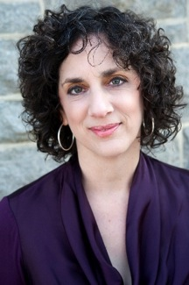
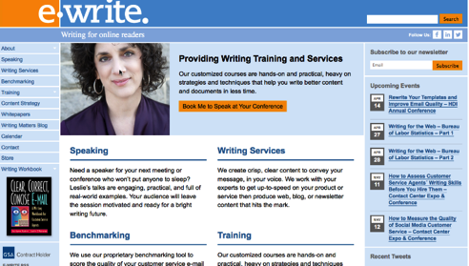
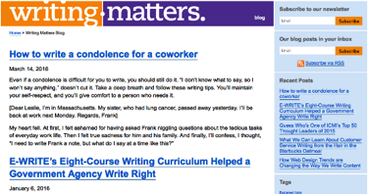








Quick intro: Leslie O’Flahavan, E-WRITE
Notes:
http://ewriteonline.com/
http://ewriteonline.com/category/writing-matters/

Slide 3
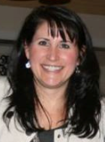

Quick intro: Kristina Lomax, Crayola
KRIS
Crayola Consumer Affairs since 1990
Los Angeles based Contact Centers
Returned to Crayola after 12 years
Oversee written response in Social Media, Email, Chat and Letters
Positive Consumer Experience = Emotional Connection
Notes:
What am I most passionate about in my role---consumer experiences. I believe a positive consumer experience originates from an emotional connection.
Challenge for us as front line staff and management is how do we make every contact sound like the first contact. How do we make it sound as if we haven’t heard that request or complaint a least 50 times this week alone?

Slide 4
How E-WRITE and Crayola have worked together
Longtime SOCAP buddies
October 2015 – E-WRITE provided customized, onsite writing training: Customer-Focused Writing at Crayola
All Crayola Consumer Affairs personnel attended the training session: email, chat, social media, and claims
Crayola has benefitted from E-WRITE presentations and webinars to develop training programs for written service
Used learnings to structure focused monitoring and coaching quality programs
Notes:
Crayola has participated in many E-Write presentations and webinars and have benefitted from Leslie’s teachings. We have created training programs from the learnings and used these insights to develop coaching programs that focused on building connections with consumers.

Slide 5
About Crayola's Consumer Affairs team
9 Front-Line Representatives; 2 Social Media Specialists
Responsible for Social, Email, Chat Written Channels
  300+ Website FAQs
  Standard Responses for Email and Web Chat
Oversee 5 Representatives
  Social Media Specialists (2)
  Lead Representatives – Non-Routine Response (2)
  International Representative (1)
170,000+ LIVE Contacts (USA & Canada)
Notes:
In 2015

Slide 6
Topics for today’s workshop
How to write and use email templates that sound natural, not robotic.
How to write live chat that builds rapport
How to avoid sounding scripted in social media
How to keep your voice and tone consistent across channels
Next steps: Short-term planning for writing that shows you care

Slide 7
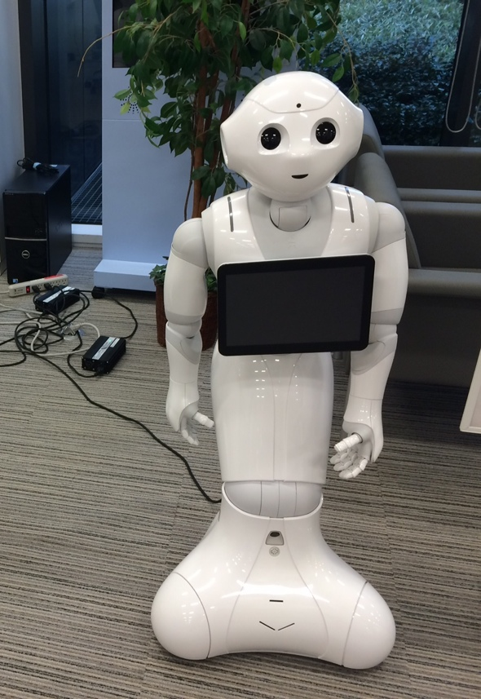

Find the customer service writer
Notes:
LESLIE TO PROVIDE EXAMPLES: This is the icebreaker activity about customer service writing that sound robotic

Slide 8
Part 1: How to write and use email templates that sound natural, not robotic.

Slide 9
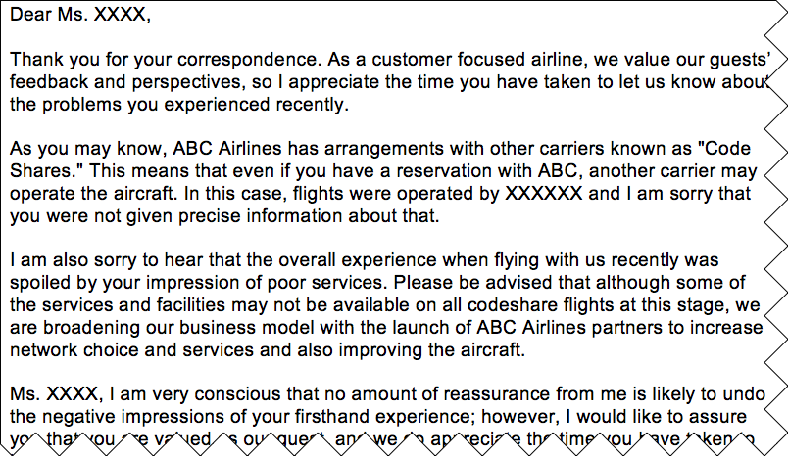
Some email templates cause the agent to sound robotic

Slide 10
This email template gives the agent room to customize and build rapport
Dear Mr. XXXX,
Thank you for writing to us about your recent travel to [destination]. I am sorry to learn about the [paraphrase service failure] you experienced on your flight operated by [codeshare or partner]. We understand that travel can be stressful, and we wish your journey had gone more smoothly.
Because your flight was operated by [codeshare or partner], I have forwarded your concerns to our counterparts there. They will contact you directly about this situation. You may also contact [codeshare or partner] directly at their [hyperlink to codeshare or partner Contact Us] page.
We look forward to welcoming you on an ABC Airlines flight again soon. Sincerely,

Slide 11
How Crayola has updated its templates
Instead of:
Thank you for your email. I apologize that we are unable to send complimentary Crayola(R) products or coupons.
Try:
I am sorry to hear about the challenges your family is facing. You’ve introduced generations to Crayola products, and we appreciate your loyalty to our brand.
Instead of:
We appreciate your contact.
Try:
Thank you for sharing your Crayola story with us!
Notes:
In training representatives, we coach a “Good/Better/Best” approach. Our templates are good—there is nothing wrong with them. They can be used when necessary, and a consumer may not notice the email wasn’t written directly for them.
Often amused by CSAT results when consumers would say “I got a canned response from the company.” Did they really not know their request was only 1 of 157,000? The answer is NO…they didn’t. So how can we make it sound like theirs is the ONLY one, and more importantly, their business is the only business that matters to us.

Slide 12
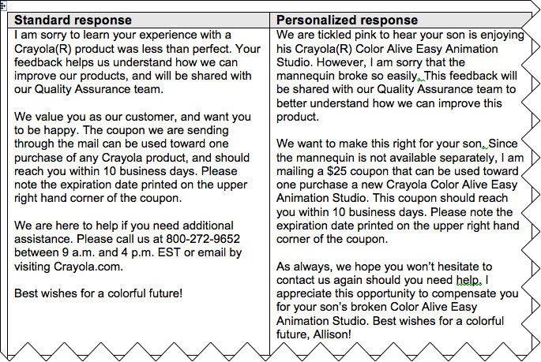
How Crayola agents use templates as talking points, not script
Notes:
Leslie---see examples in Hand Outs.

Slide 13
Part 2: How to write Live chat that builds rapport

Slide 14
Live chat and the “turn”
[Brenda] Hello, my name is Brenda; thank you for contacting us. One moment, please...
[Visitor] do you have vinyl outside corner trim in Garnet Red?
[Brenda] Yes, we offer a vinyl outside corner in Garnet Red.
[Visitor] how much is it for 4 pieces?
[Brenda] Pricing is handled through the local distributors. What is your zip code? I can let you know of a distributor in your area.
[Visitor] 20904
[Brenda] Here is a link http://ow.ly/ABC12 that will take you to a listing of ABC Products siding distributors in your area. They will be able to assist with pricing and availability.
[Visitor] Do you have an exact product number?
[Brenda] Our product code is 12345
[Visitor] Isn't it a 7-digit number
[Brenda] No, for the 3/4" x 10' long cornerpost in a woodgrain finish, our product code is 12345.
[Brenda] Is there anything else I can assist with?
[Visitor] no, thnxs
[Brenda] Thank you for contacting us. Please do not hesitate to contact us again for further assistance.

Slide 15
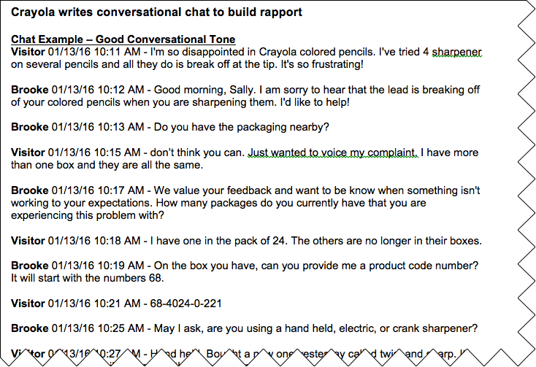
Crayola coached chat agents to achieve a conversational tone by asking more questions
Notes:
Leslie, see Hand Out example.

Slide 16
Part 3: How to avoid sounding scripted in social media

Slide 17
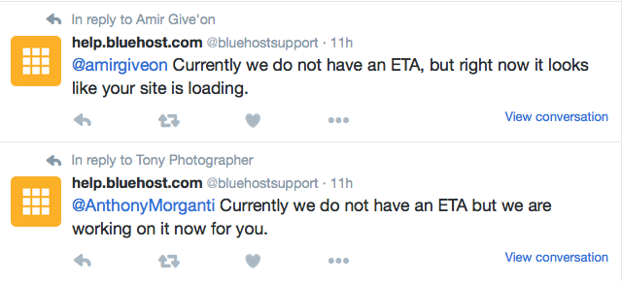
Some social customer care sounds as robotic as a form letter

Slide 18
How Crayola's social media agents use templates AND connect with customers
Consistent response is needed; uniform response is not
Answer questions first
What does the consumer want from us? Is emotion present?
What if your child, parent, grandparent asked this question? Would this be your response, tone, voice?
What if your response was blasted on social channels?
Notes:
When dealing with multiple business channels, consistent response is not only necessary but crucial to our business. Uniform response is UNEMOTIONAL.
All representatives must answer the consumers’ questions or direct them somewhere to find the information.
But more importantly, “What does the consumer want from us?” – Understanding, compensation, attention, help?
Is there an emotion present like disappointment, frustration, delight, proud of their actions. If so, ADDRESS IT!
Picture the consumer being your child, parent or grandparent. Would your response change? What if your response was out there on social media? Would you feel as if this was the best response you could provide?

Slide 19
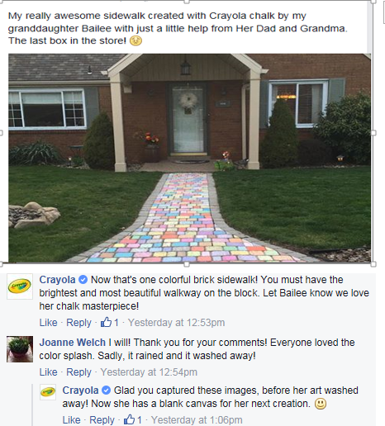
Notes:
Leslie, I have some others examples of social engagement in Hand Outs.

Slide 20
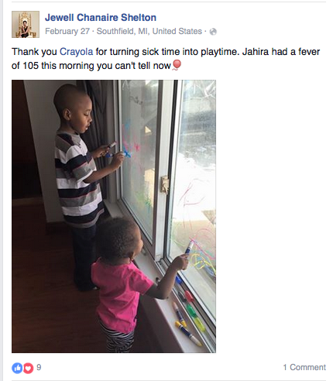
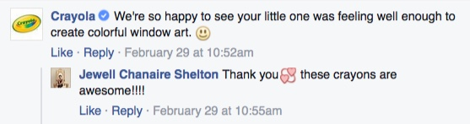

Slide 21
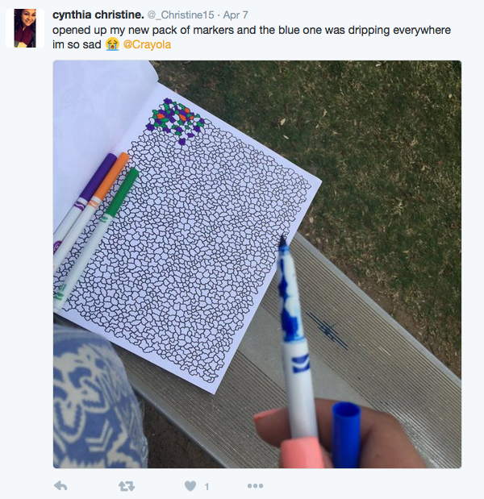
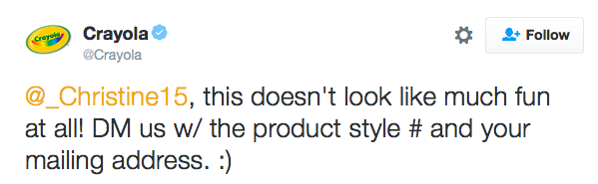
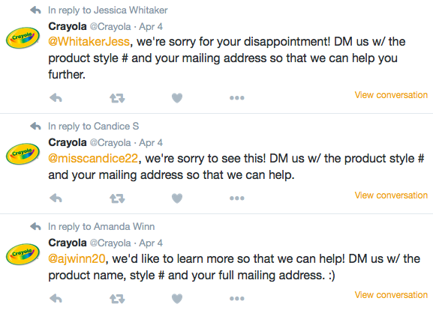

Slide 22
How Crayola's social media agents use templates AND connect with customers
ENGAGE as a friend, not a business transaction!
Notes:
If your friend showed you a piece of art they have been working on for months, would your response be “Thank you for letting me know you completed your picture.” or Would you say “WOW---that’s amazing!”
What do you think your friend wants in return from you?
Our template for complimentary emails says “Your kind comments tickle us pink. Of all the reasons people get in touch with us, it makes us most happy to know we touch the lives of others.” Is this bad? Could we have used this? But would it work in the scenario I just showed you?

Slide 23
Part 4: How to keep your voice and tone consistent across channels

Slide 24
Voice and tone should be consistent across channels, not identical
Greetings and closings
Sympathy statements
Brand claims or trademarked terms
Tagline
Instructions

Slide 25
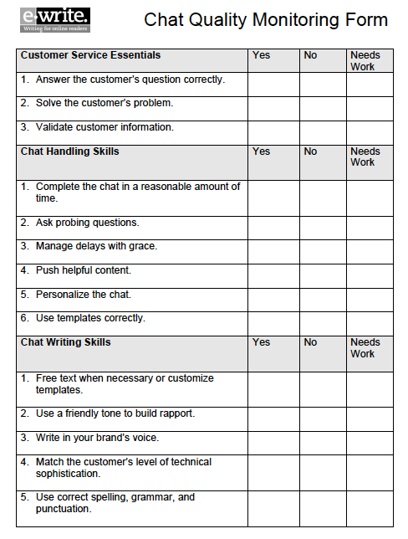
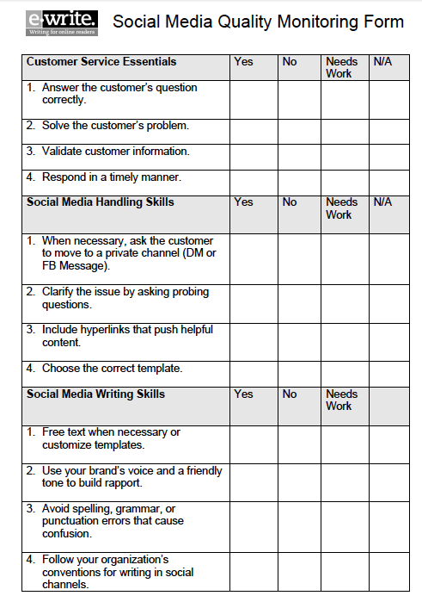
Use style guide, quality monitoring form, and definitions document to describe and maintain consistent tone
Notes:
LESLIE
Show Hawaiian Airlines style guide TOC
Talk about how Hawaiian uses its style guide
Mention E-WRITE quality forms for email, chat, and social
Talk about how to customize those forms to help maintain consistent tone across channels

Slide 26
Make your quality monitoring standards consistent across channels
Chat standards
Social standards
Free text when necessary or customize templates.
Use a friendly tone to build rapport.
Write in your brand’s voice.
Match the customer’s level of technical sophistication.
Use correct spelling, grammar, and punctuation.
Free text when necessary or customize templates.
Use your brand’s voice and a friendly tone to build rapport.
Avoid spelling, grammar, or punctuation errors that cause confusion.
Follow your organization’s conventions for writing in social channels.

Slide 27
Crayola’s Written Style Guide and
Quality Monitoring Tool
Written Style Guide and How to Say It
  Guidance for creating the CRAYOLA brand voice in written communications
Reps often “know” when a response needs something extra
Helps representatives understand:
  Our expectations
  HOW TO SAY IT
  Helps those who may be better verbal than written communicators
Shows consumers we:
  Understand them
  Want to help them
  Value them
Notes:
Explain why you prepared Crayola's How You Say It Guide and how you expect agents to use it
Show the How You Say It Guide (portions of it or all of it – up to you)
Talk about Crayola's quality monitoring plan/tool
Show the quality monitoring tool, or portions of it

Slide 28
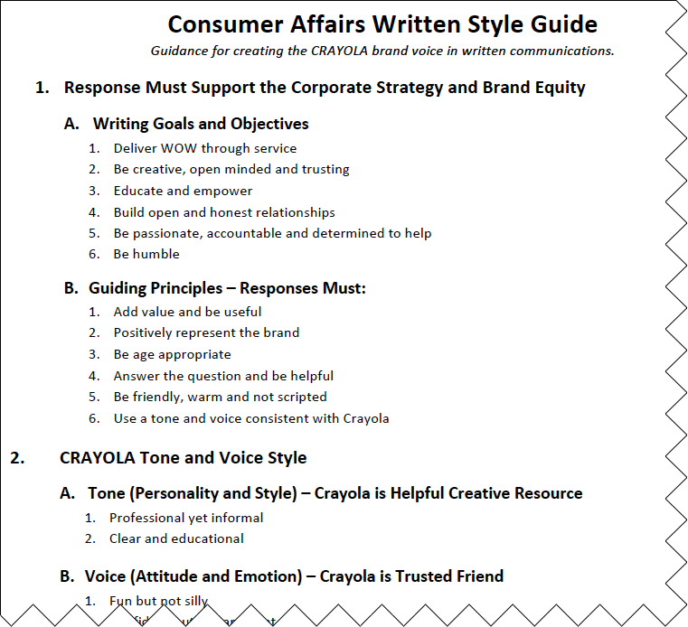
Crayola’s Writing Style Guide

Slide 29
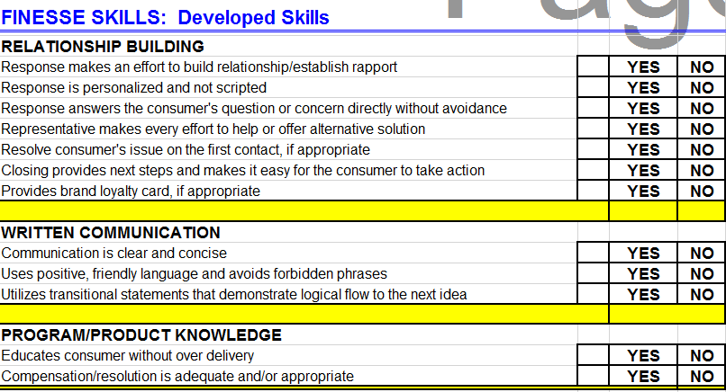
Quality Monitoring Tool
Notes:
Coupled with this training tool is our quality monitoring tool. Monitoring tool helps us zone in on Finesse skills and talk about components of relationship building. See our whole form in the hand outs.

Slide 30
Part 5: Next steps: Short-term planning for writing that shows you care

Slide 31
Next steps: Crayola’s 2016 plans
Written Style Guide
Regular Training Sessions at Front-Line Staff Meetings
  Exchange sessions such as “How Would YOU Say It?”
Caught in the Act…..of Providing Great Service
Monthly Coaching Sessions
  Focus on Emotional Connection
  Self Monitoring for Emotional Connection
Notes:
We talk A LOT about emotional connections, and I take opportunities to show them when they present themselves.

Slide 32
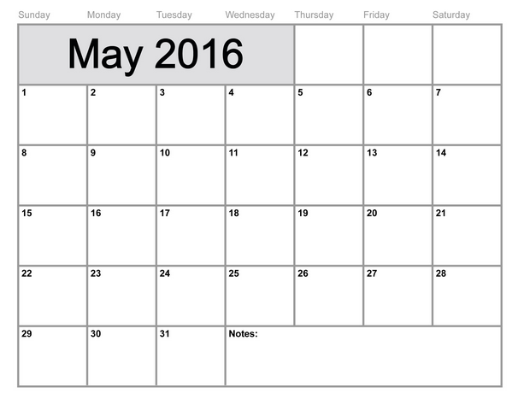
Activity: What will be your next steps in helping your team write to build rapport?
Notes:
LESLIE will lead brief planning activity here

Slide 33
QUESTIONS?
  Leslie O’Flahavan, E-WRITE
  Leslie@ewriteonline.com
  301-989-9583
  www.ewriteonline.com
  @LeslieO
Kris Lomax
CRAYOLA Consumer Affairs
Social Media Manager
610.253.6272, Extension 6220
klomax@crayola.com

